Slide 1
Covid-19 (August) Big Data Analytics
Yousef Osama
For Sprints (Eng. Ahmed Reda, Eng. Amr Saleh)

Slide 2
Agenda
01
02
03
04
05
Data load
Data Ingestion to Hadoop
Hive Queries
Ooziee WorkFlow
PowerBI Dashboard

Slide 3
MISSION STATEMENT
Create an automated pipeline workflow from ingestion till visualization for COVID dataset

Slide 4
Data Load & Data Ingestion in Hadoop
01 02

Slide 5
01 Data Load
02 Data Ingestion to Hadoop
Creating Directories on the Virtual machine to work on
Creating Directories on the Hadoop to work on
Moving the Covid-19.csv (the data) to the machine using Winscp
Put the Covid-19.csv (the data) to the Hadoop File system

Slide 6
03
Hive Queries

Slide 7
Done using Notepad++ to .HQL files
Staging Table
Pointing to dataset location to select data from
Partitioning
ORC table is partitioned by Country and data are loaded dynamically into it to speed query
Output
generate the final report which will generate output file to be visualized

Slide 8
04
Oozie Workflow

Slide 9
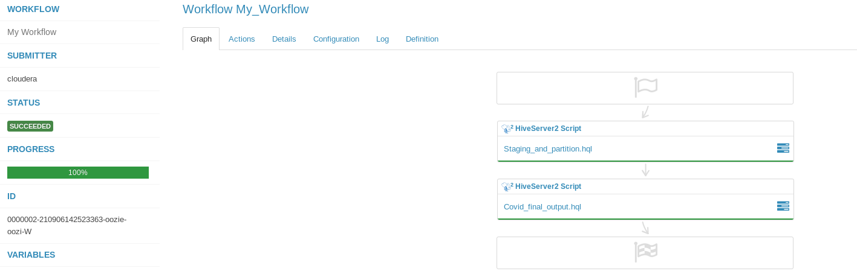
Through Hue Workflows
The HDFS script couldn’t work for technical issue, as a result it was done through the Terminal
HQL files had to be separated into two files

Slide 10
05
PowerBi Dashboard

Slide 11
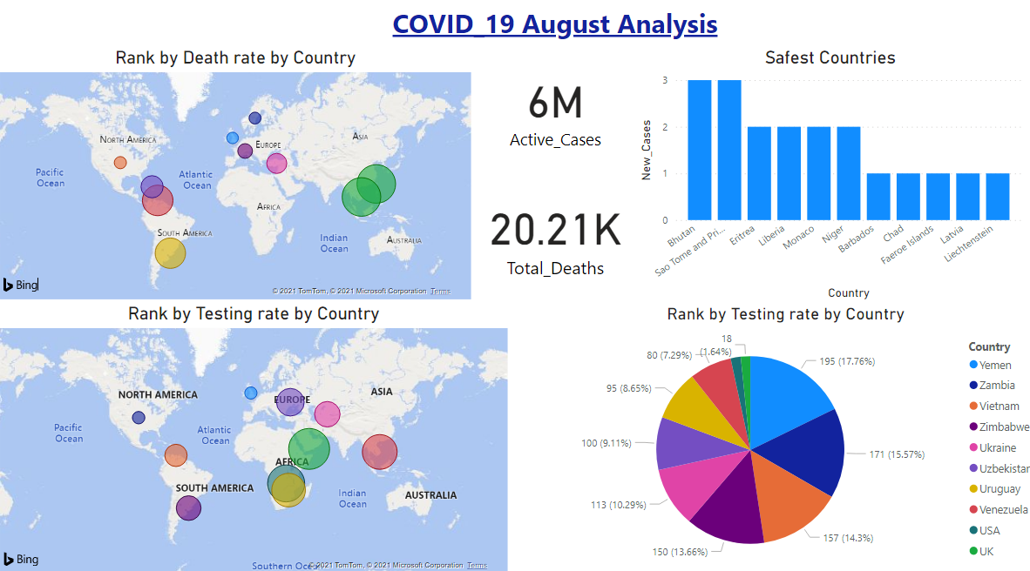
1st Dashboard
Map charts for Death and Test rates in Countries (Top 10)
Card 1: 6 Million active case world-wide
Card2: 20.21K death in August world-wide
Safest countries that have the lowest case numbers
Pie chart for testing rates in countries (Top10)

Slide 12
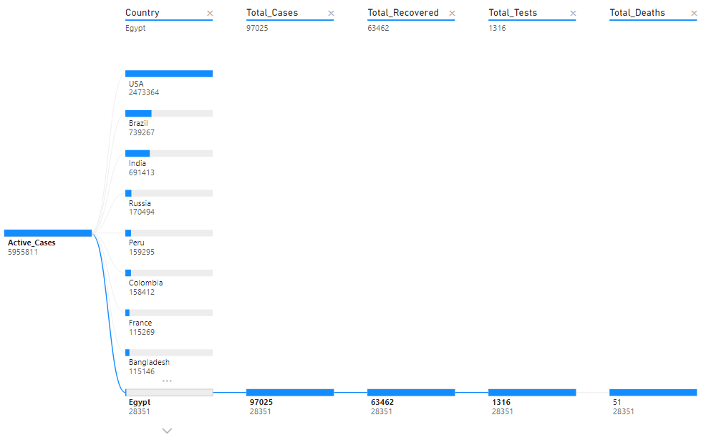
2nd Dashboard
Tree Diagram for an analytical view for each countries from the perspective of:
Total Cases
Total Recovered
Total Tests
Total Deaths
N.B: Pressing any country will show the numbers in the selected country

Slide 13
THANKS
Note for Ahmed Reda & Amr Saleh:
Thank you so much for your incredible support, effort and motivation to explore the big data world, gracious and really appreciate your knowledge and knowing you was a great privilege indeed.

Slide 14
THANKS
Do you have any questions?
addyouremail@freepik.com
+91 620 421 838
yourcompany.com
Please keep this slide for attribution

